Slide 1

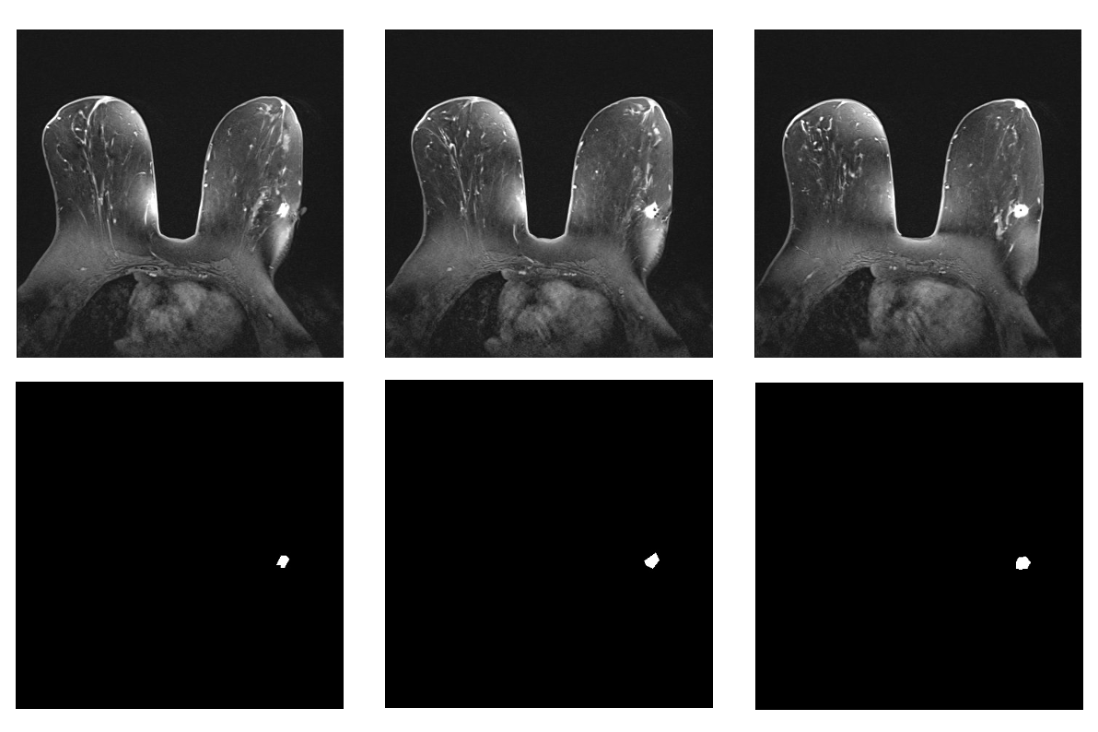
Radiomics 4- How to use
MRI Images – Data acquisition -> Image Pre – processing & Segmentation-> PyRadiomics-Feature Extraction
Images were extracted from: https://nbia.cancerimagingarchive.net/nbia-search/
Later from each image, a mask file was created Using the editing software “ImageJ”. There you need to circle the tumor using polygon selection And create the mask function: edit -> selection -> create mask save image and mask in this format: Image_XX , Mask_XX
Notes:
Breast cancer, the second most prevalent form of cancer among women globally, can also affect men. The BRCA1 and BRCA2 genes play a crucial role in DNA repair within cells, and alterations in these genes can elevate the likelihood of developing breast cancer. Nonetheless, it is important to note that not all cases of breast cancer are attributable to BRCA mutations, and not all women possessing these mutations will inevitably develop breast cancer.

Slide 2
Radiomics 4- How to use
MRI Images – Data acquisition -> Image Pre – processing & Segmentation->PyRadiomics-Feature Extraction
The image and mask files should be saved in a csv under headlines : Image, Mask. In the terminal where the project is saved you need to run this command in order to extract the features from pyradiomics : change path to input to the appropriate csv file from before and results.csv to place you want the output to be saved. Combine all of the data extractions to one file.
Notes:
Breast cancer, the second most prevalent form of cancer among women globally, can also affect men. The BRCA1 and BRCA2 genes play a crucial role in DNA repair within cells, and alterations in these genes can elevate the likelihood of developing breast cancer. Nonetheless, it is important to note that not all cases of breast cancer are attributable to BRCA mutations, and not all women possessing these mutations will inevitably develop breast cancer.

Slide 3
Radiomics 4- How to use
Correlation with gene expression -> Classification and Prediction
Add to the CSV file from before a column named: “targets” which are the groups in this experiment, 1 or 0 ( in our case, 1 stands for BRCA mutation).
Later, use the module as is. You need to change the correct path to the input files on your computer. All the needed files can be taken from GitHub.
How to run the model:
Open a project in Python, add the main function to your own project.
To run the program you need to download the following libraries: NumPy, Panda, sklearn, pickle
The import commands are already in the code. You can choose how many features you want to consider as important.
There is a possibility to save the module after the training. These features are commented on and need to be uncommented if you want to use them.
Notes:
Breast cancer, the second most prevalent form of cancer among women globally, can also affect men. The BRCA1 and BRCA2 genes play a crucial role in DNA repair within cells, and alterations in these genes can elevate the likelihood of developing breast cancer. Nonetheless, it is important to note that not all cases of breast cancer are attributable to BRCA mutations, and not all women possessing these mutations will inevitably develop breast cancer.

